Slide 1
Don’t Be a Friend. Be a Parent.
Carroll County, Maryland
Social Host Awareness Media Campaign

Slide 2
Carroll County, Maryland
Rural/Suburban
Population of 71,714
9 High Schools
2 Colleges
Home of the Maryland Wine Festival
Microbrew festivals
31 alcohol retailers in
Westminster

Slide 3
SPF funded to reduce underage drinking in our community
Contributing Factors of Underage Drinking in Carroll County
Retail availability Low perceived risk Social availability

Slide 4
Social Availability
86% felt that adult hosting is at least somewhat a problem;
23% felt that it is a serious problem.
Source-MSPF Carroll County Needs Assessment

Slide 5
“I have been to a house where alcohol was given to the teens by the parents. I was one of those teens. I didn’t mind it because the family was cool about it and that allowed me to relax and have a good time. As long as they didn’t drive and put their keys away, they could drink.”
Carroll County Coalition Against Underage Drinking Blog Post 2012

Slide 6
Social Availability
Easy or very easy for underage youth to obtain alcohol from:
Older siblings (88%),
Parents (75%), and
Friends (100%).
Source-MSPF Carroll County Needs Assessment

Slide 7
“I think that now a days it is more important for a parent to be “cool” and try to be their child’s best friend instead of actually protecting them from something harmful.”
Carroll County Coalition Against Underage Drinking Blog Post 2012

Slide 8
Don’t be a Friend. Be a Parent. The Campaign
Campaign Goals
Parents aware of Maryland social hosting laws and consequences.
Consequences of underage drinking:
Binge drinking,
Alcohol poisoning,
Sexual assault,
DWI/DUI, and
Alcohol dependence.
Our Vision,
Supported by
SAMHSA

Slide 9
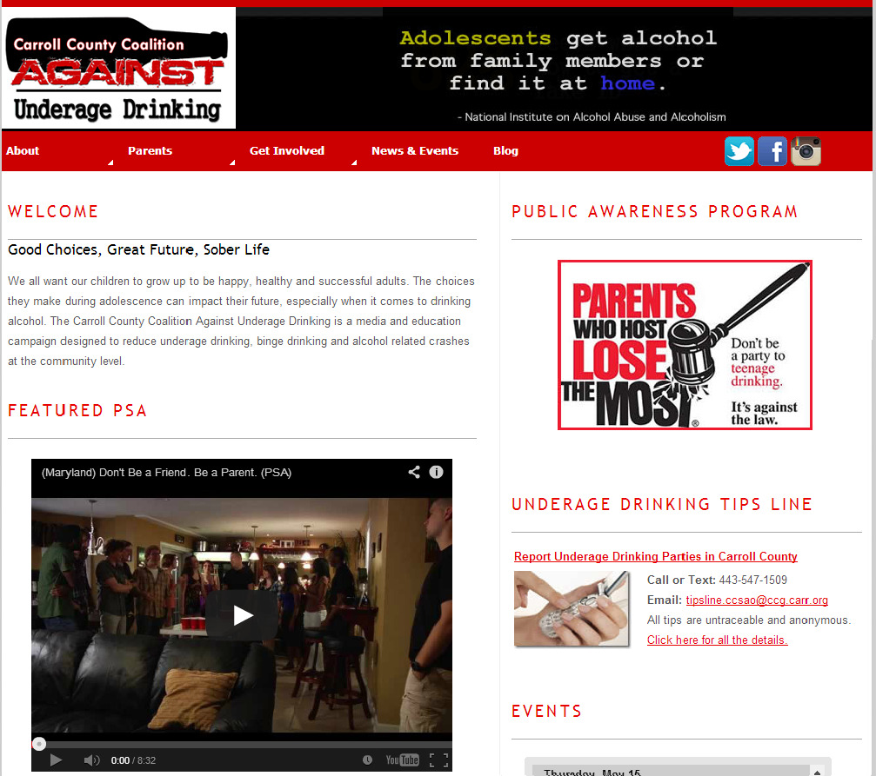

Slide 11
Public Service Announcement
SAMHSA produced the Maryland Underage Drinking Video, July 2013.
Our coalition wanted to expand the use of the video and social host prevention message to a broader audience by creating PSAs from the original video.

Slide 13
Print Uses
Using video stills from the original video to show underage drinking consequences.
Bus
Newspaper
Billboards
Posters
Coalition website
Social media
Don’t Be a Friend. Be a Parent.

Slide 16
Connecting the Campaign to Our Environmental Strategies
Alcohol Retailer Compliance Checks
Underage Drinking Tips Line
Project Sticker Shock

Slide 17
Carol Mullen
Coalition Coordinator
410-876-4802
carol.mullen@maryland.gov
www.carroll-coalition.org

